Slide 1
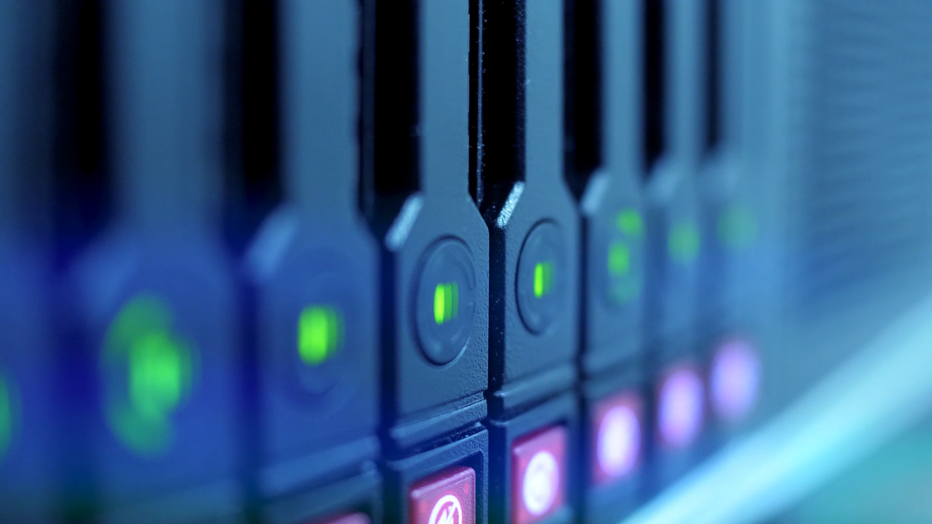
IOT BASED BANK LOCKER SYSTEM

Slide 2
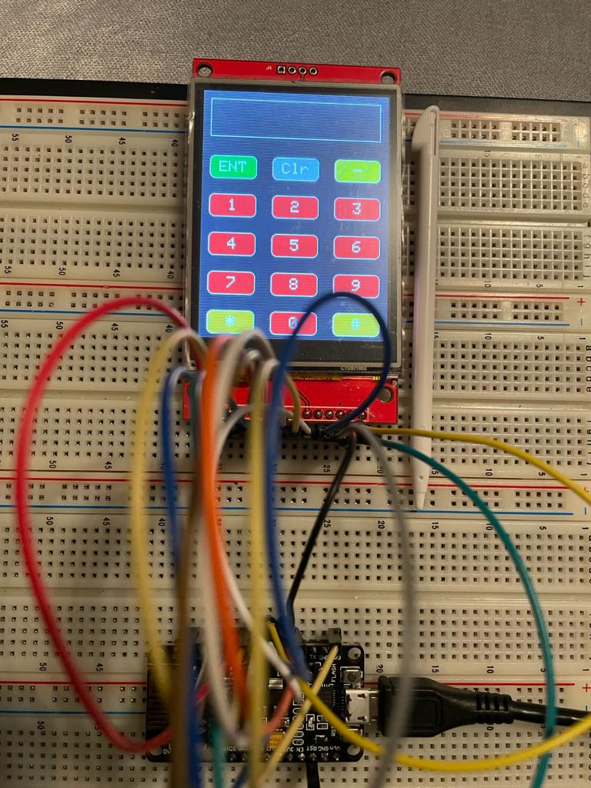
GUI for Touchscreen
SIMRAN
Group: 2
C0765503

Slide 3
WHAT IS UI(USER INTERFACE)?
User interface, or UI, describes the way in which a human interacts with a machine. Though technically something as simple as a light switch could be considered an instrument of UI, most modern references relate to computers and other electronic devices
UI makes the exchange between users and machines possible. Without it, this vital form of communication ceases to exist.

Slide 4
Goal of UI?
User interfaces enable users to effectively control the computer or device they are interacting with. This is the main principle of UI technology.

Slide 5
TYPES OF UI
Command Line Interface: Command Line Interface requires users to type appropriate instructions into the command line.
Menu-driven Interface: The menu-driven user interface provides you with a range of commands or options in the form of a list or menu displayed in full-screen, pop-up, pull-down, or drop-down. An ATM is an example of a menu-driven interface.

Slide 6
TYPES OF UI
Graphical User Interface: The graphical user interface, or GUI, is the type of interface with which most of the people are familiar. You interact with these interfaces by using a mouse, tack pad, or other peripheral to point and click on graphics or icons.
Touchscreen Graphical User Interface: The touchscreen GUI is very similar to the regular GUI, except that you use your fingers or a stylus to select icons and perform tasks, rather than a mouse or trackpad. Touchscreen GUIs are commonly found on tablets, smartphones, and many more electronics devices that are used on daily base. Main privilege of Touchscreen GUI is that it is mainly used by the fingers and this avoids the lack of peripherals.

Slide 7
What is GUI?
A graphical user interface (GUI) is a type of user interface through which users interact with electronic devices via visual indicator representations.
Beyond computers, GUIs are used in many handheld mobile devices such as MP3 players, portable media players, gaming devices, smartphones and smaller household, office and industrial controls.
Touchscreen GUI is the advance form of GUI, which help the user to interact with the machine using fingers or stylus, and this advancement in GUI assist the user to avoid extra peripheral devices like mouse or keypad.

Slide 8
What is GUI?
Graphical user interfaces are easier for most end users to understand as the icons and menus are generally self-explanatory.
User does not require to remember or input complex commands as compared to the earlier UI’s.
Storage is also more as compared the pervious UI’s.

Slide 9
Requirements
Hardware Requirements
Software Requirements
2.8” TFT Touch screen
Breadboard
ESP8266
Jumper wires
USB Wire
Stylus
Arduino IDE

Slide 10
TFT Touch screen
TFTs, also called TFT screens, are a type of active-matrix LCD display capable of displaying millions of high-contrast, clear and bright color pixels. TFTs are used in HDTV sets, computer monitors, laptop monitors, tablets, personal media players, smartphones and even feature phones.

Slide 11
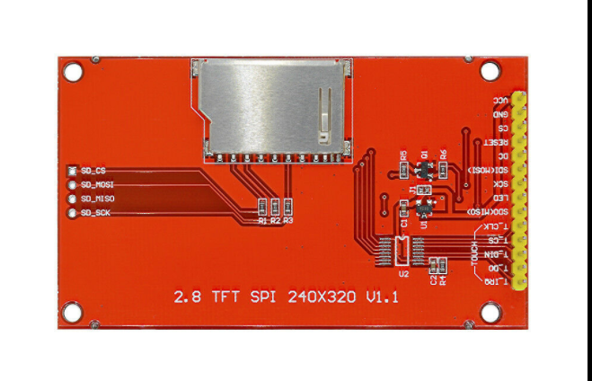
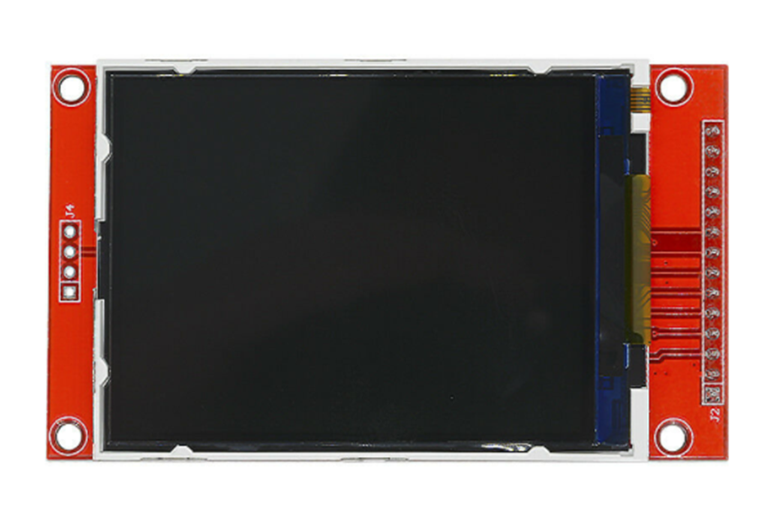
2.8” TFT Touch Screen

Slide 12
2.8” TFT Touch Screen
This is a 2.8-inch serial SPI color display module with touch function. It supports both analog SPI and hardware SPI. It is designed with PC plate including power supply IC and SD.
better performance in terms of adjusting the pixels within the display to get better quality.
Durable hard PCB ILI9341 board and metal, ideal for 5110 interface
Support Serial Mode and hardware SPI, so very convenient to use.
5V compatible, use with 3.3V or 5V logic

Slide 13
Features
Resolution: 240x320
Driver IC: ILI9341
Input Voltage: 5V/3.3V
Color: 64k
Display Module: 1
Display area: 46(W) X 65(H)mm
Size: 86 x 50 mm

Slide 14
Role of Touch Screen in my project
We are using the touch screen as a first level security, for the Bank locker System.
So, the user need to enter the password before using the fingerprint sensor.
If the password, does not match then directly the buzzer will activate and the image will be taken by the camera, and send to the cloud.
If the password matches then, the fingerprint sensor is activating, and the fingerprints match, locker will open.

Slide 15
Role of GUI in my project
As I am using 2.8” TFT touchscreen with SPI MODULE in my project.
The BANK LOCKER is basically operated by two users: one is the OWNER and the Other is CO-OWNER.
So, the 2 Passwords will be entered on the screen as per given the coding.
Now, the Screen needs the buttons and the text area, where the user can enter the password, so this task is performed by GUI.

Slide 16
Role of GUI in my project
Total of 15 buttons are created on the screen including 0-9 numeric, with the * and #.
The special buttons ENTER, CLEAR and - are also created on the screen.
The user need to enter the correct password, and the message will be print on the screen whether its OWNER or CO-OWNER.
If the password matches then, the fingerprint sensor is activating, and the fingerprints match, locker will open.
If the password, does not match then directly the buzzer will activate and the image will be taken by the camera, and send to the cloud.

Slide 17
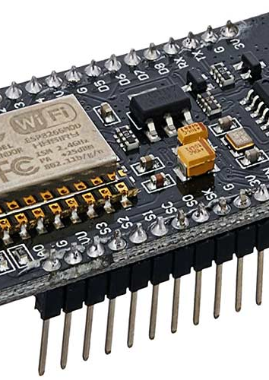
ESP8266
The NodeMCU (Node Microcontroller Unit) is an open-source software and hardware development environment built around an inexpensive System-on-a-Chip (SoC) called the ESP8266.
The ESP8266, designed and manufactured by Espressif Systems, contains the crucial elements of a computer: CPU, RAM, networking (Wi-Fi), and even a modern operating system and SDK.

Slide 18
Features of ESP8266
This microprocessor supports RTOS and operates at 80MHz to 160 MHz adjustable clock frequency.
NodeMCU has 128 KB RAM and 4MB of Flash memory to store data and programs.
High processing power with in-built Wi-Fi / Bluetooth and Deep Sleep Operating features make it ideal for IoT projects.
NodeMCU can be powered using Micro USB jack and VIN pin (External Supply Pin).
It supports UART, SPI, and I2C interface.

Slide 19
Role of ESP8266 In this project
ESP8266, is used in this project only as a bridge between the touchscreen and Beagle bone black.
ESP8266 is being interfaced with the 2.8” TFT touch screen using the SPI communication protocol.

Slide 20
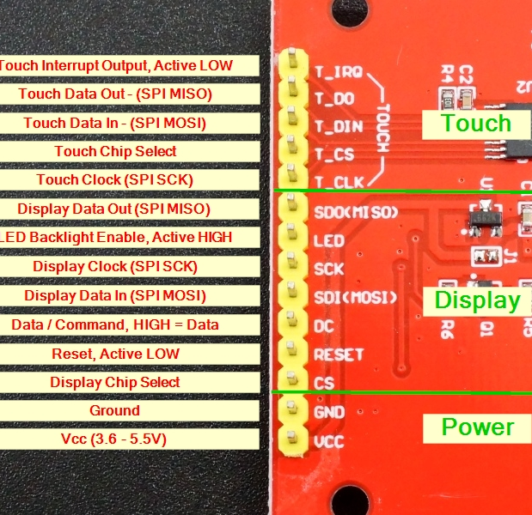
Pin description Of Touch screen

Slide 21
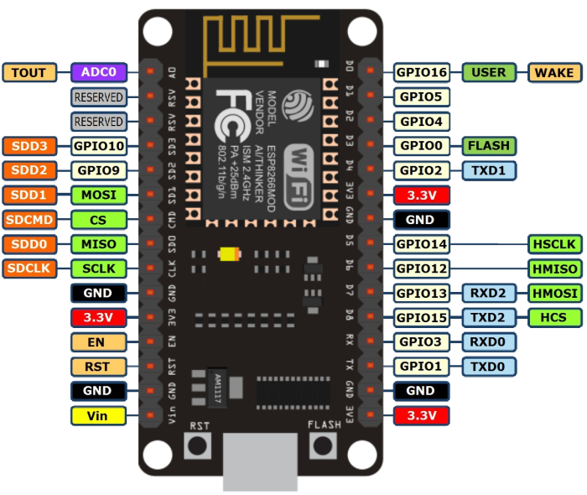
Pin description of ESP8266

Slide 22
What the communication protocol for developing GUI?
Earlier, I performed the interfacing of TFT touchscreen with ESP8266 using SPI communication protocol, which is called as SERIAL PHERIPHERAL INTERFACE.
This is a 4-wire communication which has 4 main pins SCK which is clock signal, CS which is Chip Select, MISO which is Master in slave out and lastly, MOSI which is Master out Slave in.
Now, for the development of GUI, for touch screen SPI communication protocol is used.

Slide 23
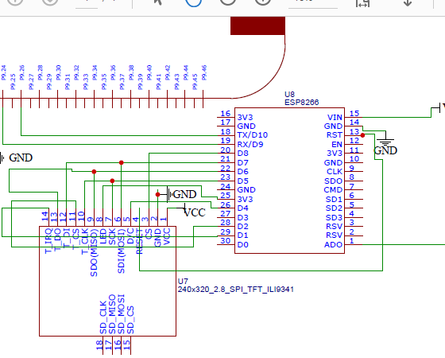
Schematic design

Slide 24
Hardware connections
ESP8266 | TOUCH SCREEN
3.3V | VCC
GND | GND
D8 (15) | CS
RST | RESET
D4 (2) | DC
D7 (13) | SDI
D5 (14) | SCK
3.3V | LED
D6 (12) | SDD

Slide 25
HARDWARE CONNECTIONS
ESP8266 | TOUCH SCREEN
D5 (14) | T_CLK
D2 (4) | T_CS
D7(13) | T_DIN
D6 (12) | T_DO
D1(5) | T_IRQ

Slide 26
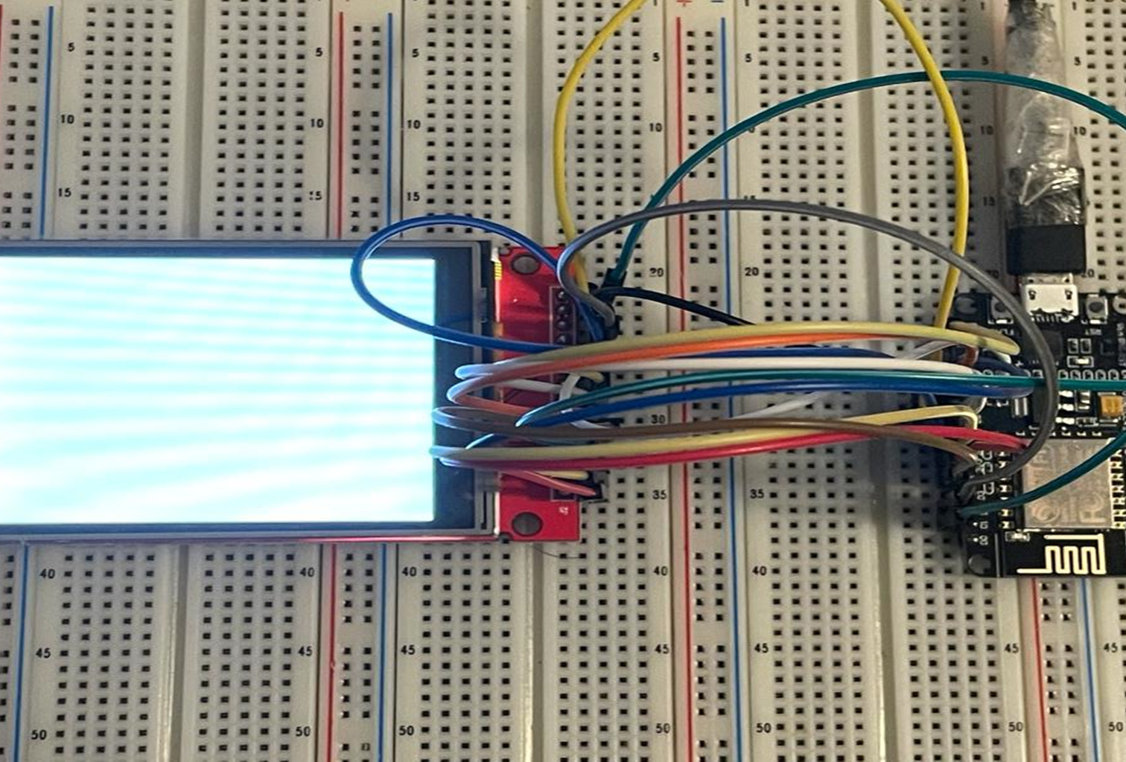
CONNECTIONS

Slide 27
Arduino IDE
Earlier, I did the interfacing of touchscreen with ESP8266, the text was displayed on the screen using the Arduino IDE.
Similarly, for GUI Arduino IDE is used as a software Tool.
Also, we need to download esp8266 board in the Arduino IDE.
The required libraries for the GUI need to be downloaded before loading the code.
Code is written in the window, and after complaining, flash the code in the ESP8266 BOARD, and the output will be displayed on the screen, with various buttons and text field.

Slide 28

Adding the required Libraries
For developing GUI on touchscreen and further connecting the screen with ESP8266, 3 libraries need to installed in Arduino IDE before, flashing the code in ESP8266
Adafruit_GFX: This library is for the graphics.
Adafruit_ILI9341: This library is for the TFT library.
XPT2046 : For touch controller

Slide 29
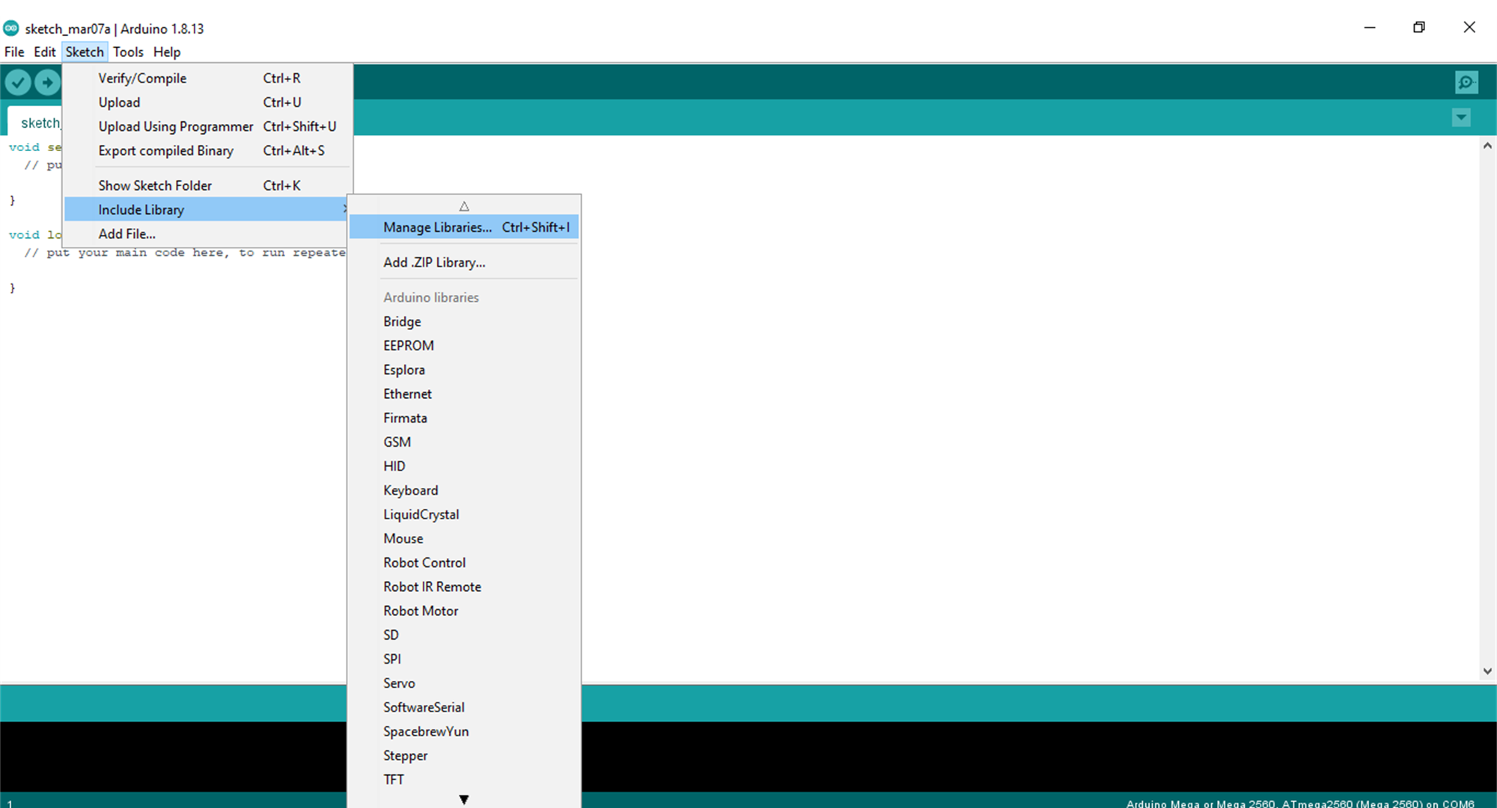
Steps to add library

Slide 30
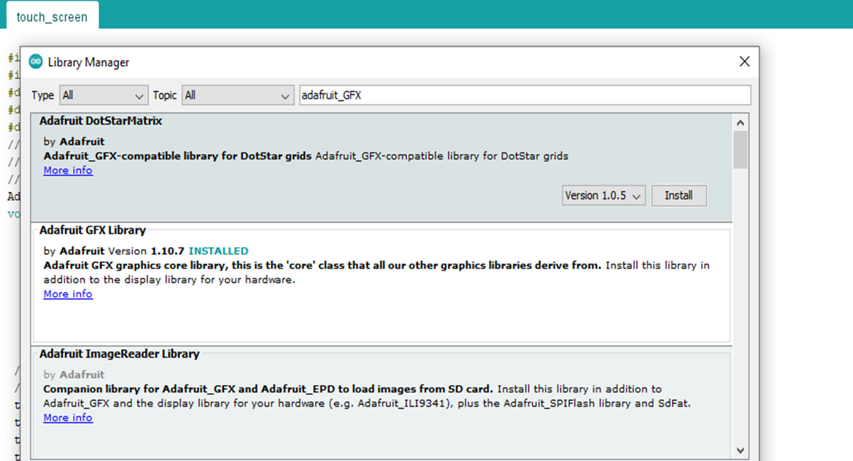

Slide 31
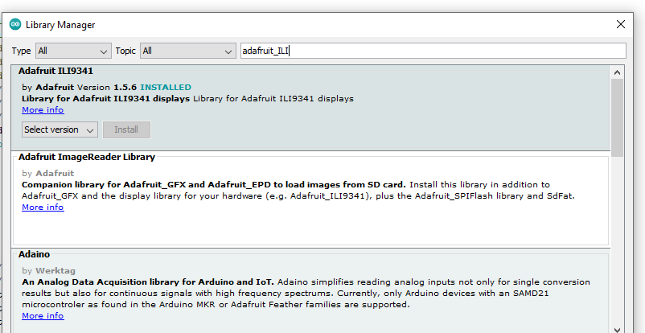

Slide 32
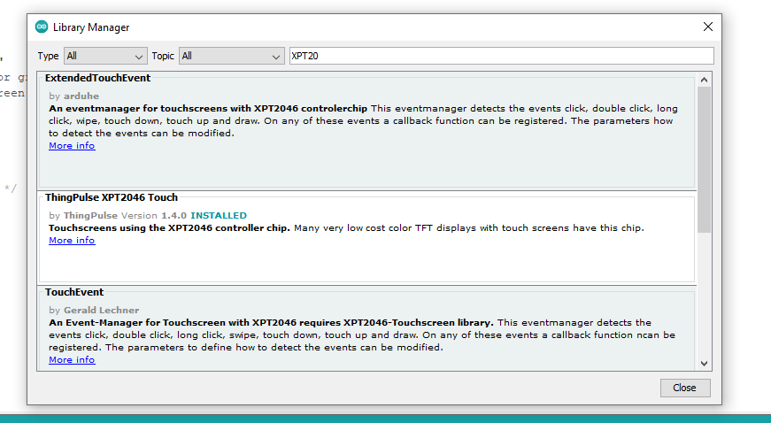

Slide 33
Touch calibration
Touch calibration plays a vital role before developing the GUI.
Basically, Calibration is matching the graphics on the display to the output from the touch-screen controller.
In other words, converting the display coordinates to touch coordinates.
These coordinate values are different for different screen.

Slide 34
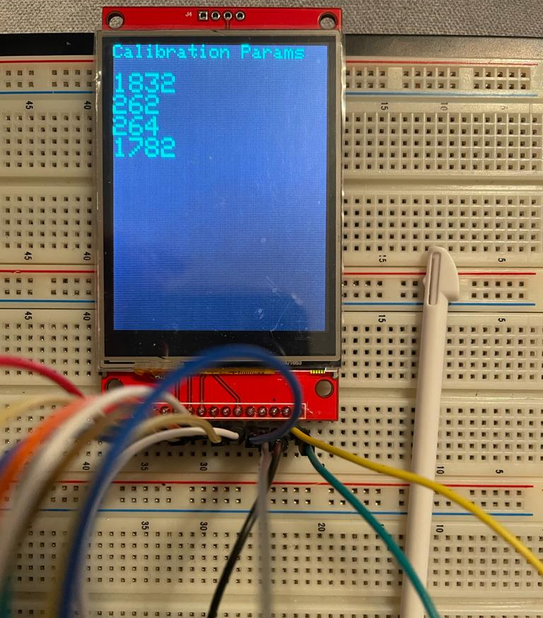
Output

Slide 35
CODING

Slide 36
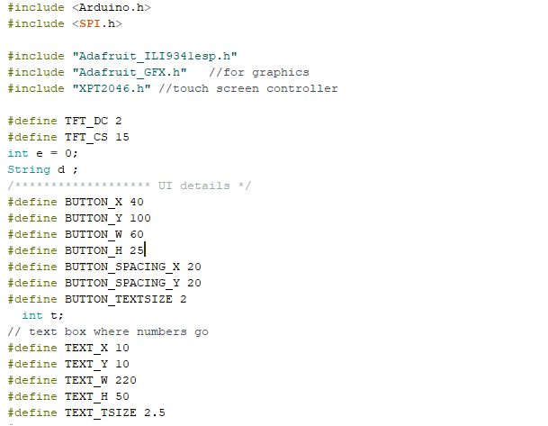
Here, all the libraries required for the GUI are included in the code.
The CS and DC are defined in the code
Some integer and string variables are initialized.
The basic configuration for button and text field are defined as global

Slide 37
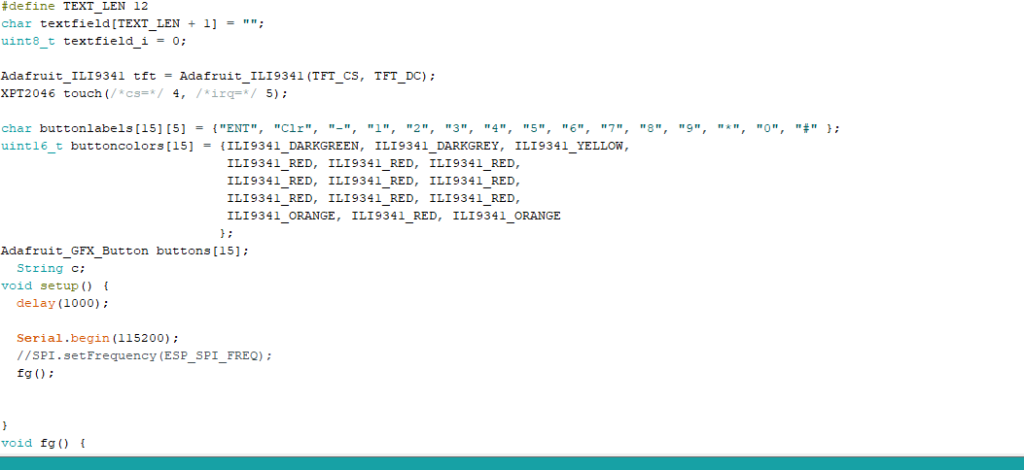
The text field length is defined with size of 12 Here, all the labels for buttons and there colors are defined. As all the numeric are defined with RED color and the Enter is defined with DARKGREEN, Clear with DARKGREY, and – with YELLOW. The #, * are defined with orange.

Slide 38
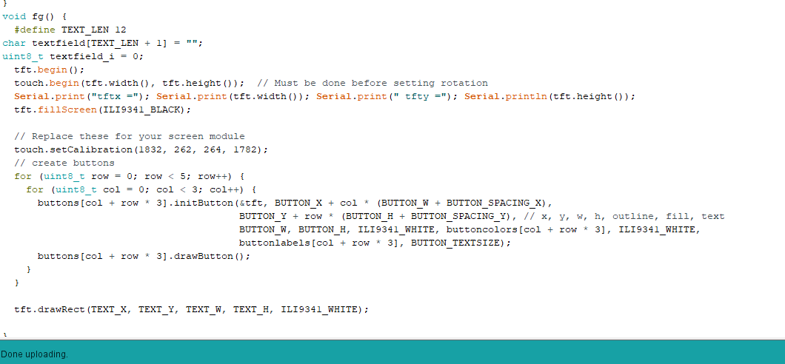
Here, the buttons and text field are created as per values that are defined above. Buttons are created with drawbutton command and text field is created with drawrect command

Slide 39
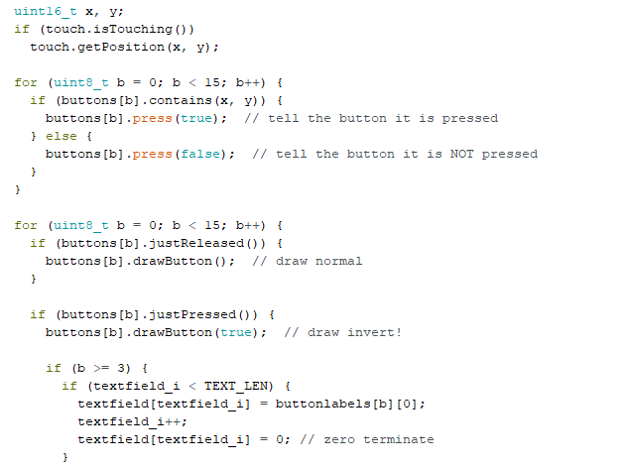
When the button is pressed
To released the button

Slide 40
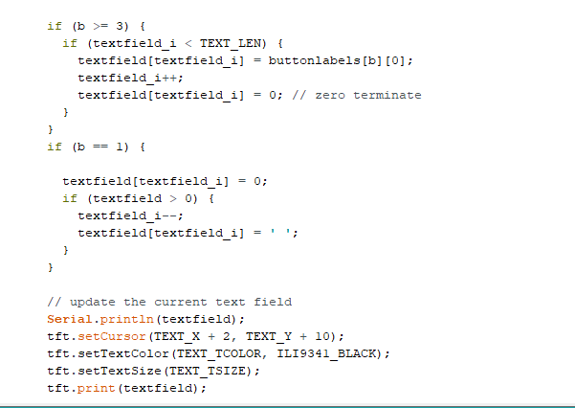
Reading the values for touch screen, like this part help in the display the content in the text field, when the button is pressed.
The will help to clear the content from the text field
This will help the user to update the text field

Slide 41
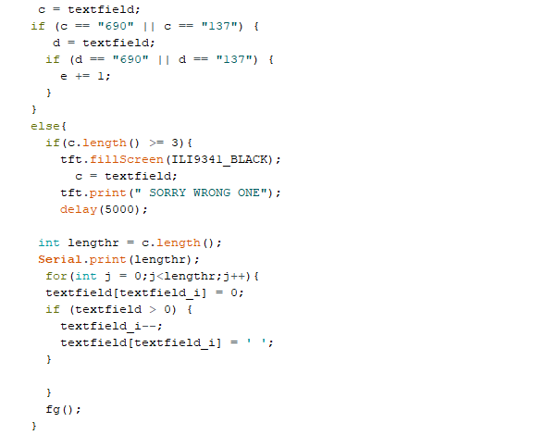
If the wrong password entered, the message SORRY WRONG ONE will appear on the screen, and then delay of 5 seconds all the buttons and text field will clear and again fg() function is called.
Once the buttons are pressed, whether they are wrong or correct, all the buttons are cleared from the screen with some delay and again appear on the screen
Again calling the function

Slide 42
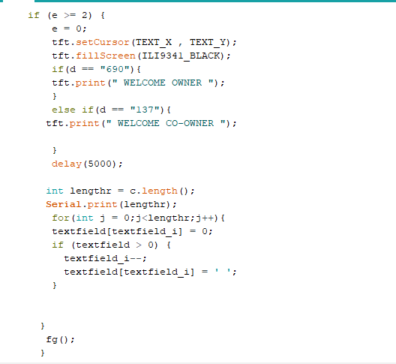
This part shows that there are 2 users to the locker and there are two passwords saved in the code. Enter “690” returns WELCOME OWNER. Entering “137” returns the WELCOME CO-OWNER.

Slide 43
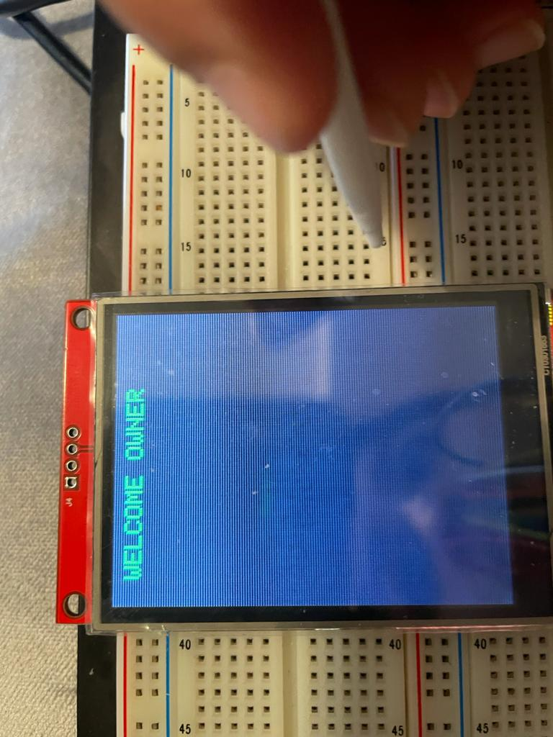
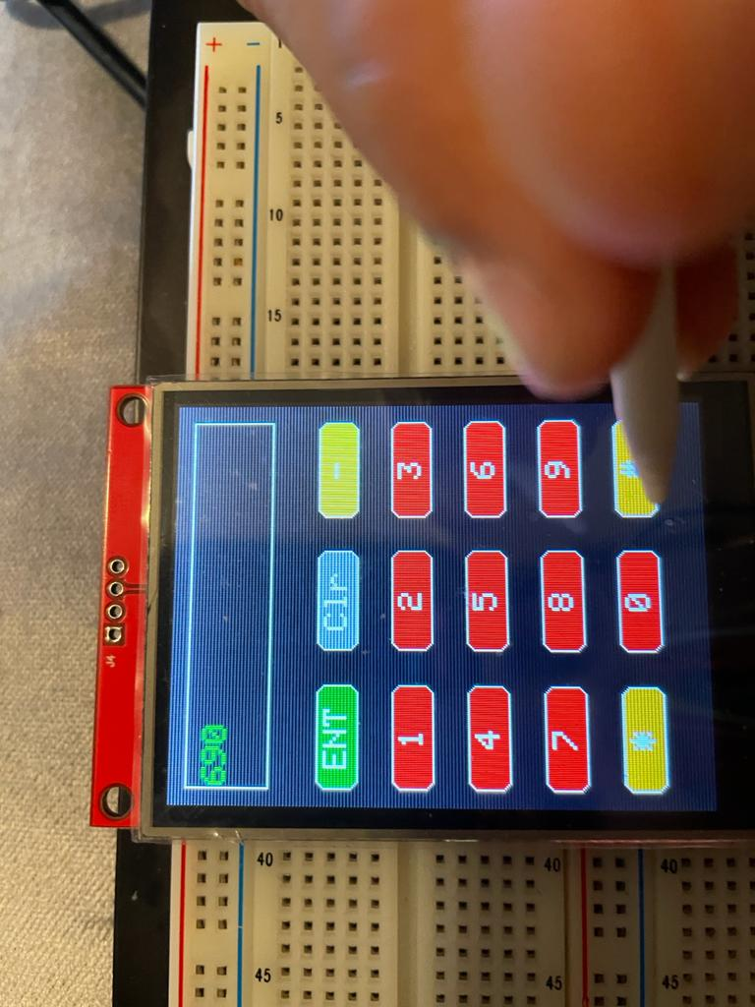
output

Slide 44
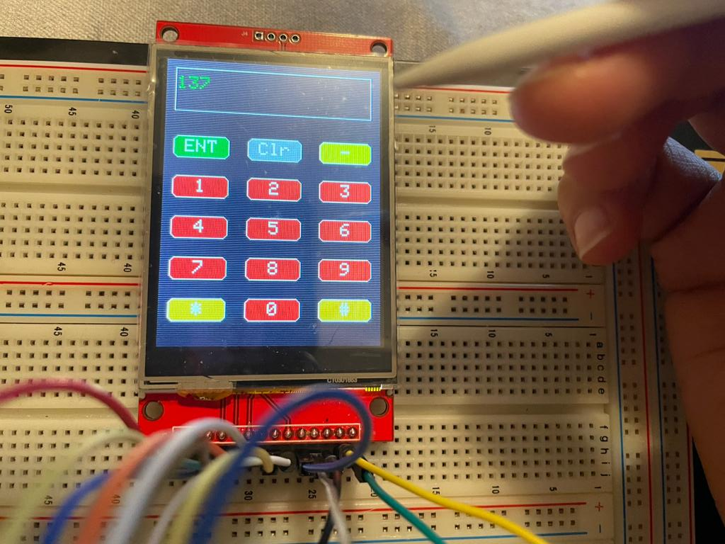
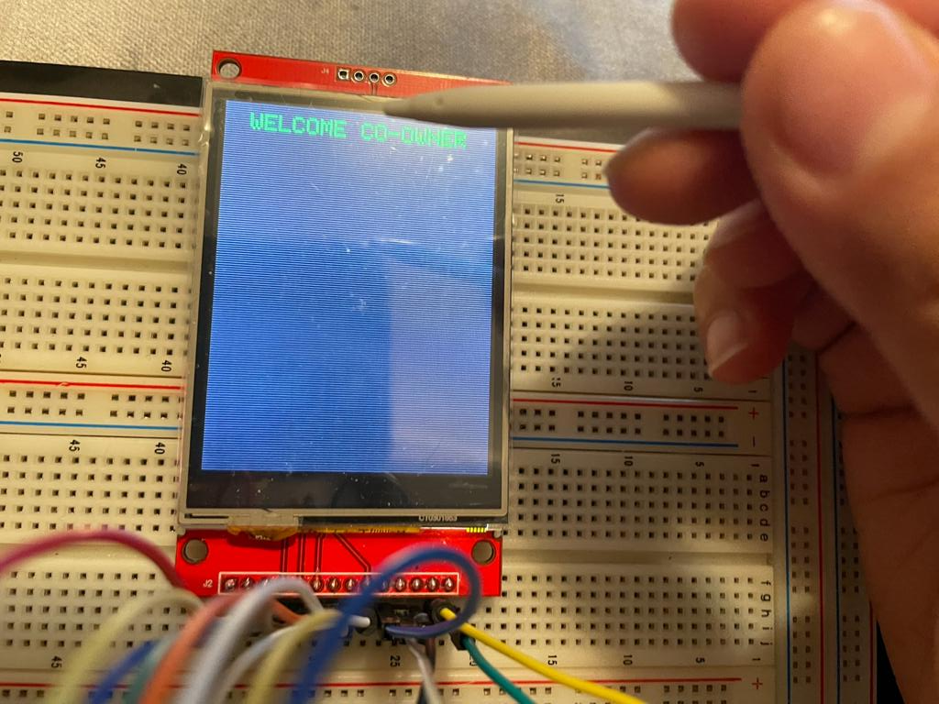
output

Slide 45
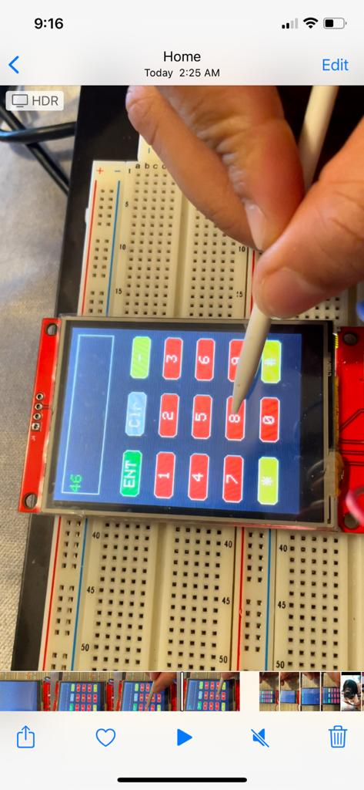
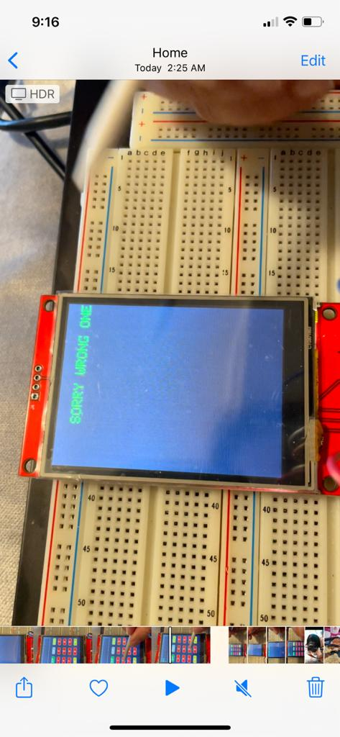
Output with Wrong password

Slide 46
References
For SPI: https://www.circuitbasics.com/basics-of-the-spi-communication-protocol/
For SPI: https://learn.sparkfun.com/tutorials/serial-peripheral-interface-spi/all
For libraries: https://protosupplies.com/product/tft-lcd-2-8-240x320-rgb-spi-display-with-touchscreen/
Pin Manual: http://www.lcdwiki.com/res/MSP2807/2.8inch_SPI_Module_MSP2807_User_Manual_EN.pdf
Touchscreen: https://www.amazon.ca/Display-Module-240x320-Serial-ILI9341/dp/B07BDML7LM/ref=pd_sbs_3?pd_rd_w=lNfqj&pf_rd_p=ac0ba40f-1b2a-4803-91f7-9d36ccf6dbf9&pf_rd_r=957MY4CXH80WZS18T1AS&pd_rd_r=261b631a-d12e-4b5d-973b-5b066d763a32&pd_rd_wg=e7nNi&pd_rd_i=B07BDML7LM&psc=1

Slide 47
References
GUI fOR touchscreen with ESP8266: https://nobrok.com/connecting-tft-lcd-touch-screen-with-nodemcu-esp8266/
Interfacing touch screen with ESP8266: https://simple-circuit.com/esp8266-nodemcu-ili9341-tft-display/
Interfacing touch screen with ESP8266: https://www.youtube.com/watch?v=jgfdkedoNfE
Graphics library: https://learn.adafruit.com/2-8-tft-touchscreen/graphics-library
Adafruit ILI9321: https://learn.adafruit.com/adafruit-2-8-tft-touch-shield-v2/graphics-test

Slide 48
Refernces
Types of UI: https://www.altia.com/2014/09/22/different-types-of-ui/
XPT2046: https://www.arduino.cc/reference/en/libraries/xpt2046_touchscreen/

